Slide 1
The Cake-Baking Challenge
void bakeChocolateCake() {
std::cout << "Baking a chocolate cake!" << std::endl;
}
template <typename CakeType>
void bakeCake(CakeType cake) {
std::cout << "Baking a " << cake << " cake!" << std::endl;
}
void bakeVanillaCake() {
std::cout << "Baking a vanilla cake!" << std::endl;
}
Strawberry?
Mango?

Slide 2
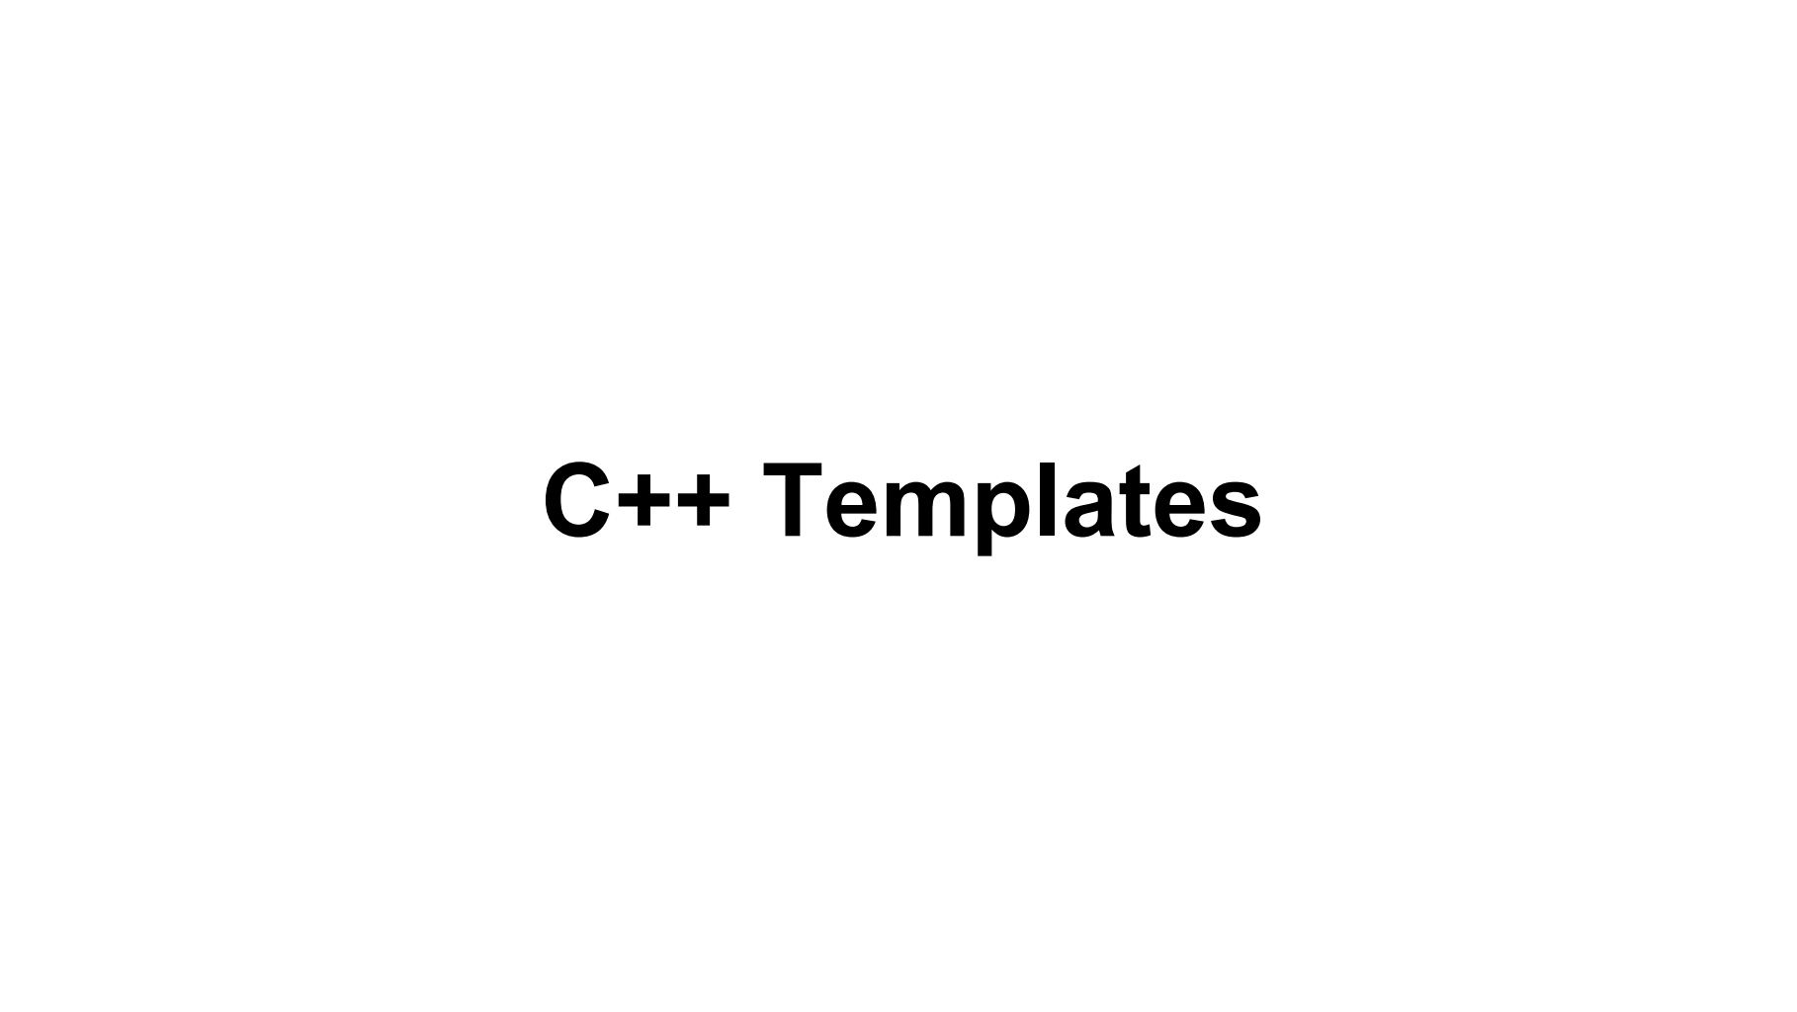

Slide 3
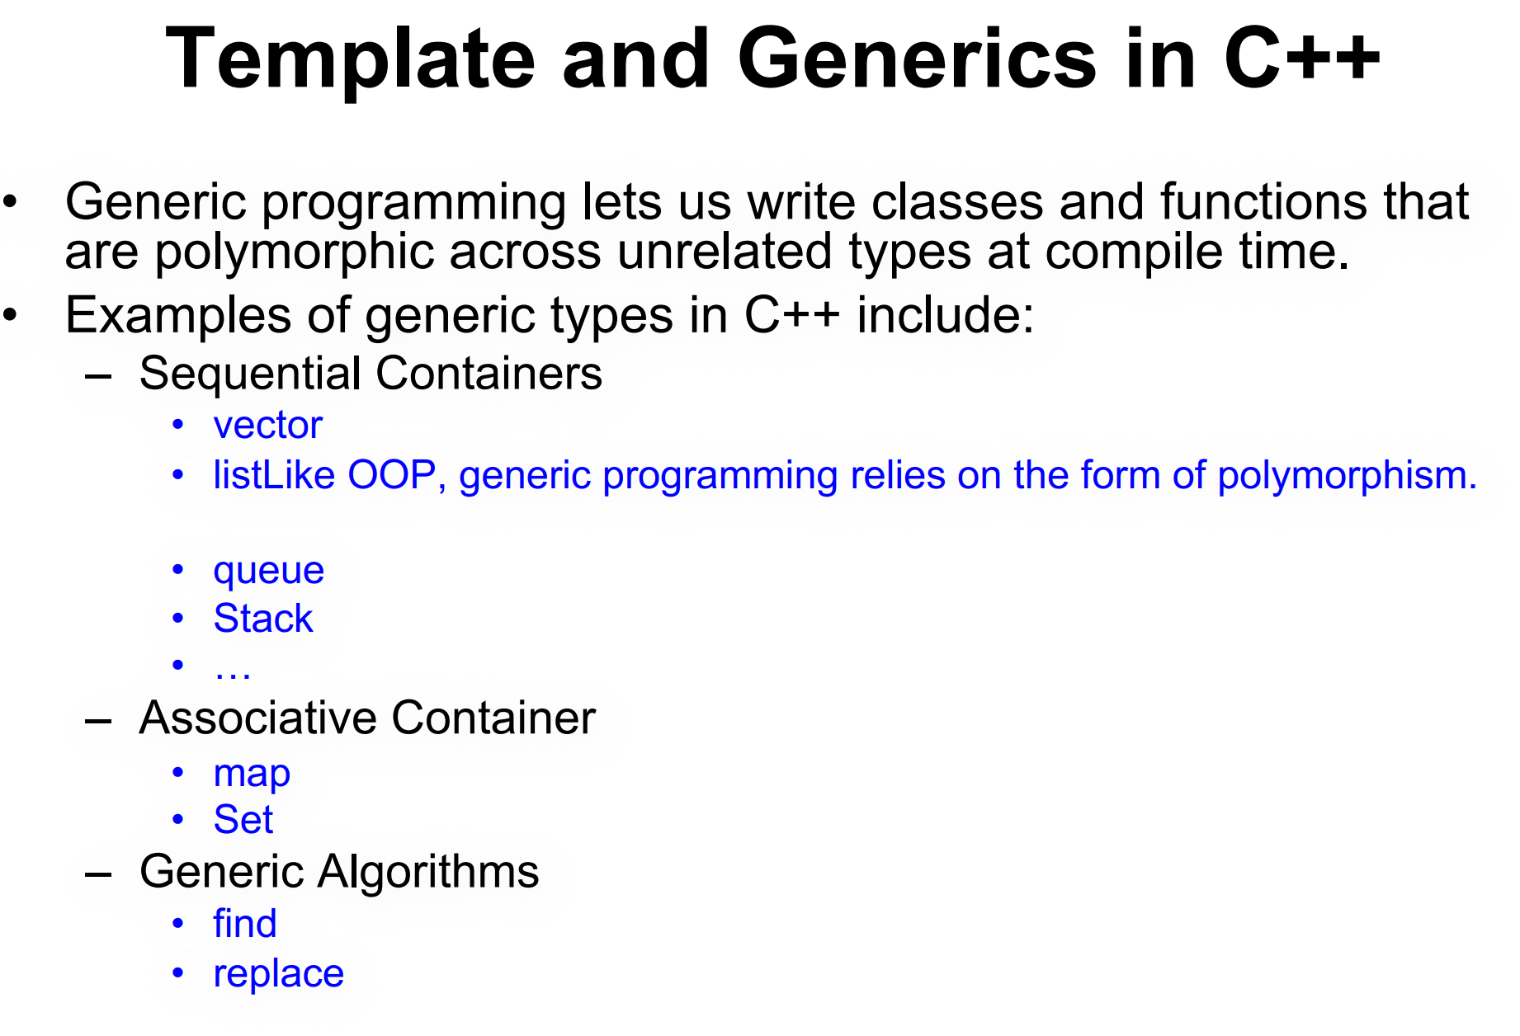

Slide 4
Types of templates
Function Templates
Class Templates

Slide 5
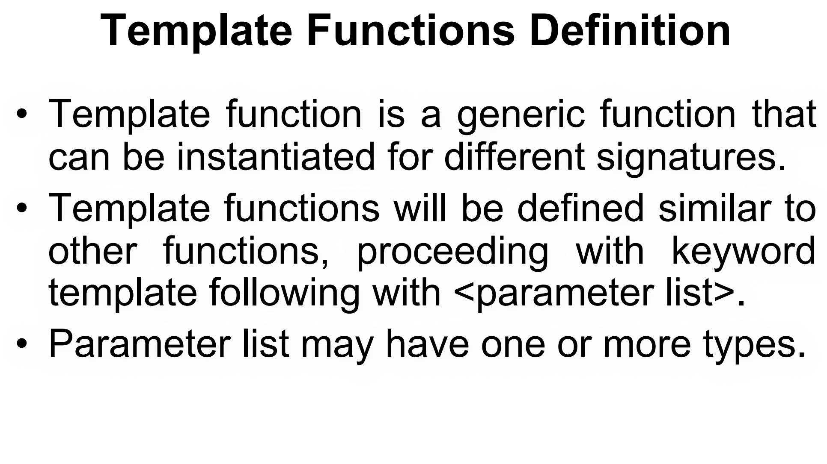
template <typename T>
T functionName(T parameter1, T parameter2) {
// Function body
}
template <typename T, typename U>
auto add(T a, U b) -> decltype(a + b) {
return a + b;
}

Slide 6
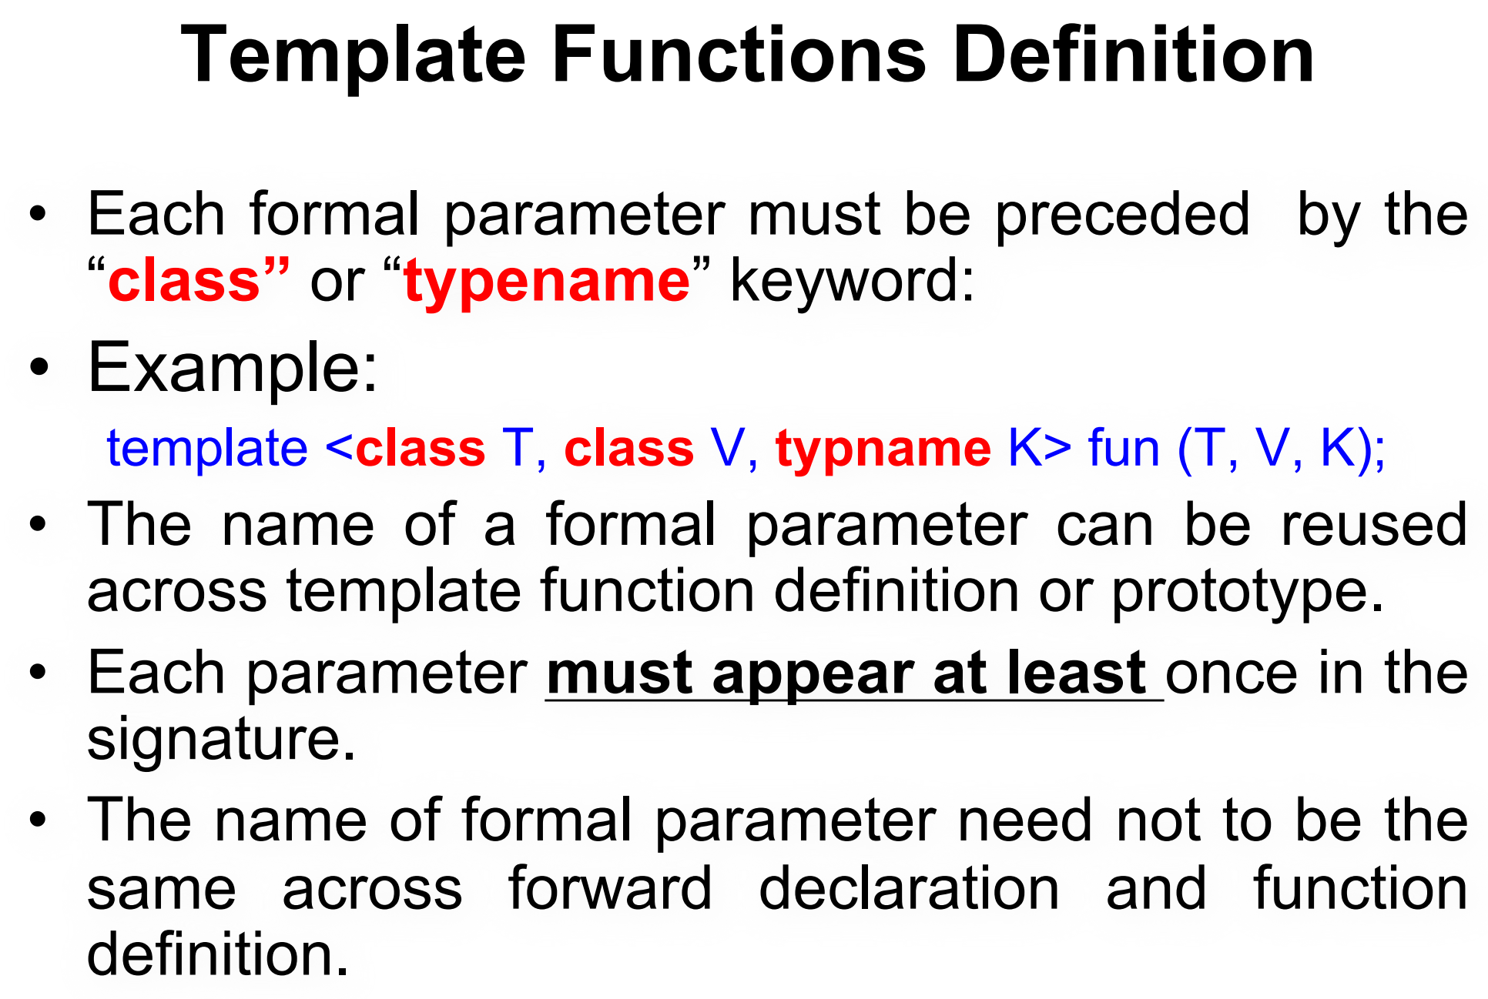

Slide 7
The name of a template parameter does not need to match across different declarations of the function.
template <typename X, typename Y>
void display(X, Y);
template <typename A, typename B>
void display(A a, B b) {
// Function body
}

Slide 8
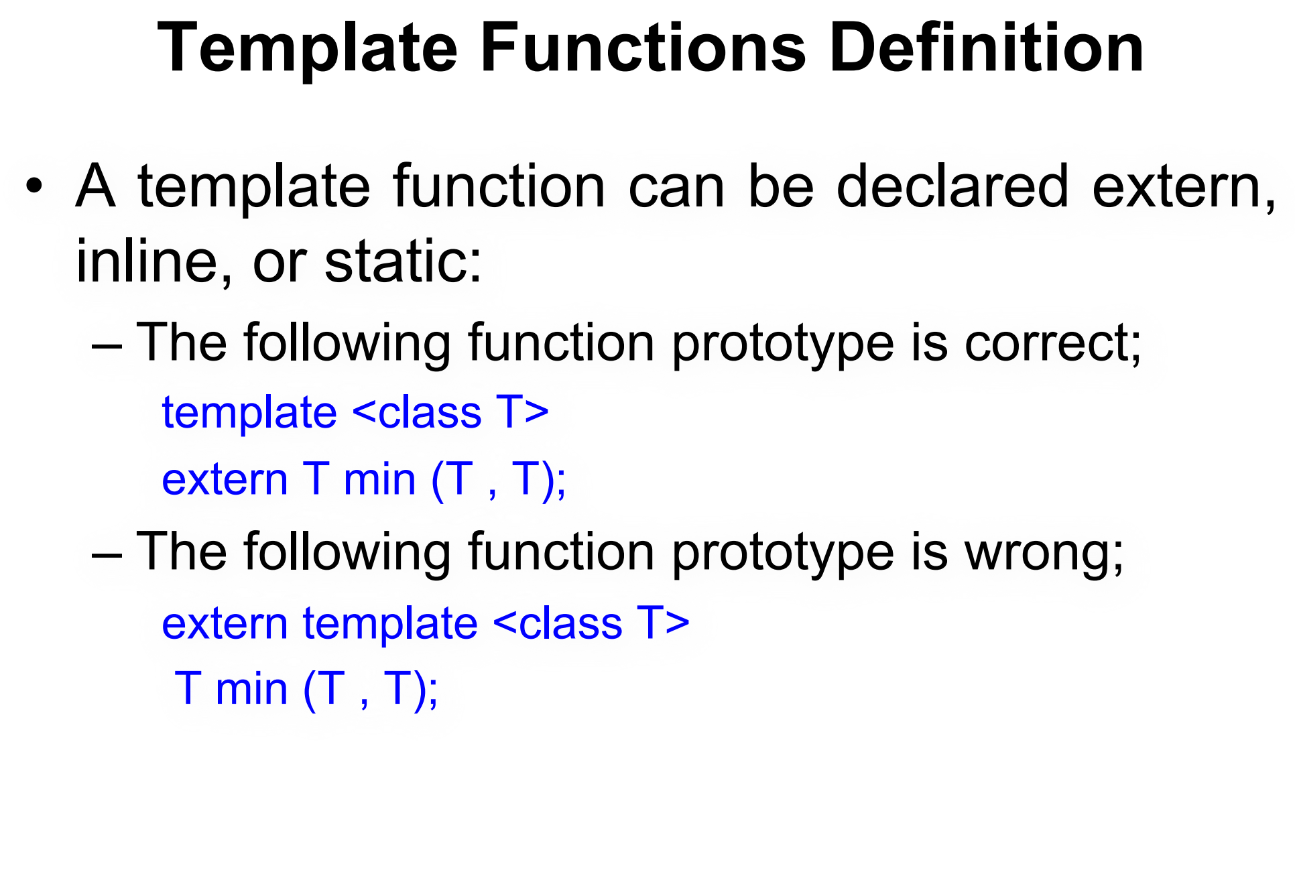
template <class T>
inline T square(T x) {
return x * x;
}
template <class T>
static T subtract(T a, T b) {
return a - b;
}

Slide 9
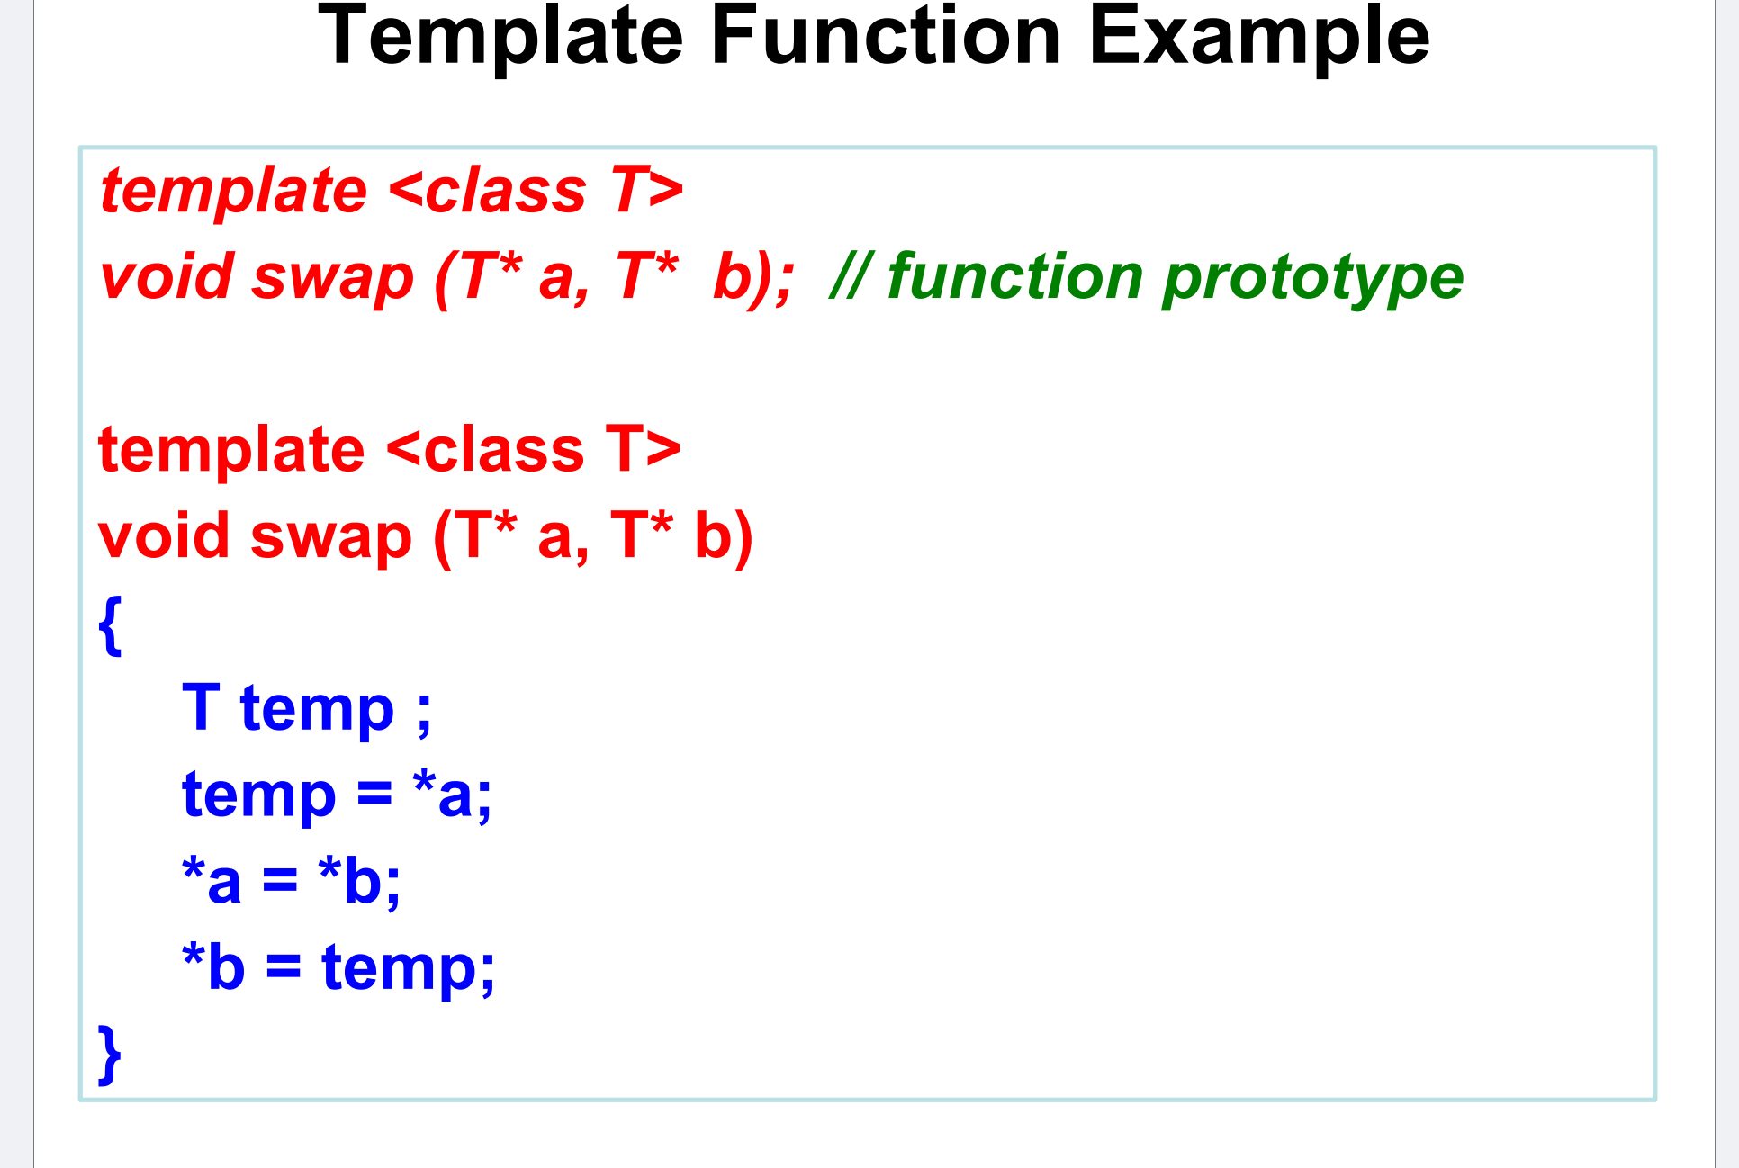

Slide 10
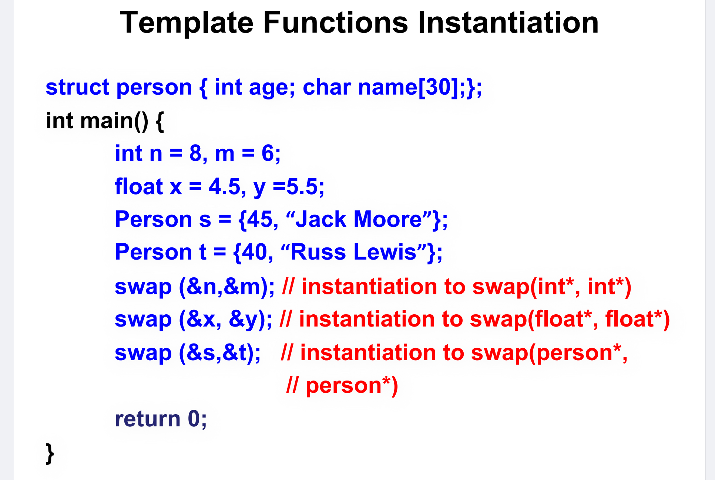

Slide 11
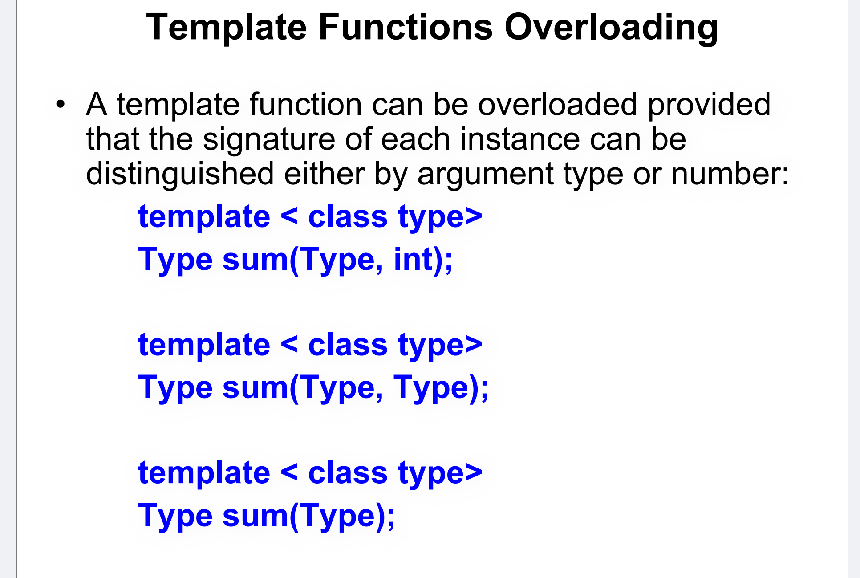

Slide 12
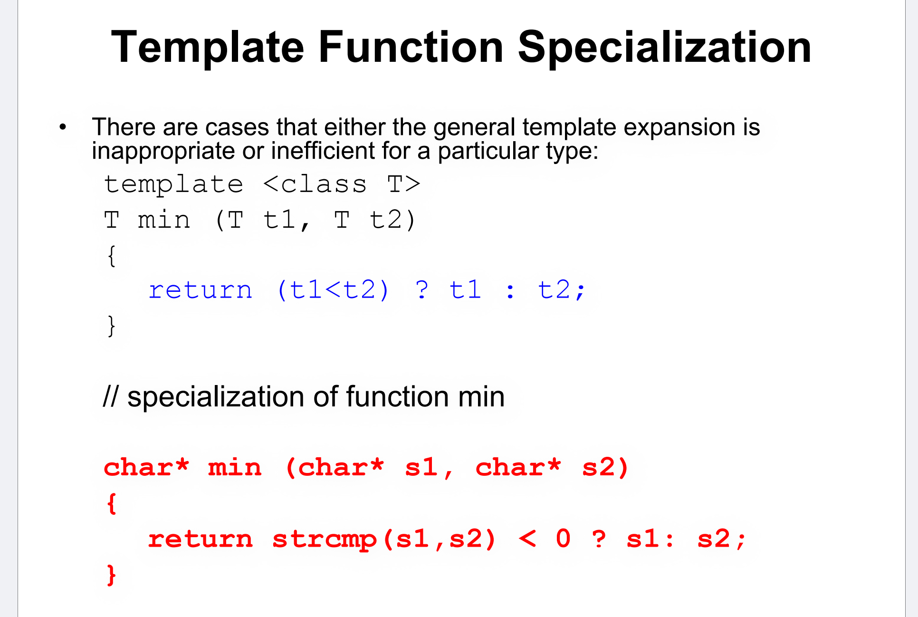

Slide 13
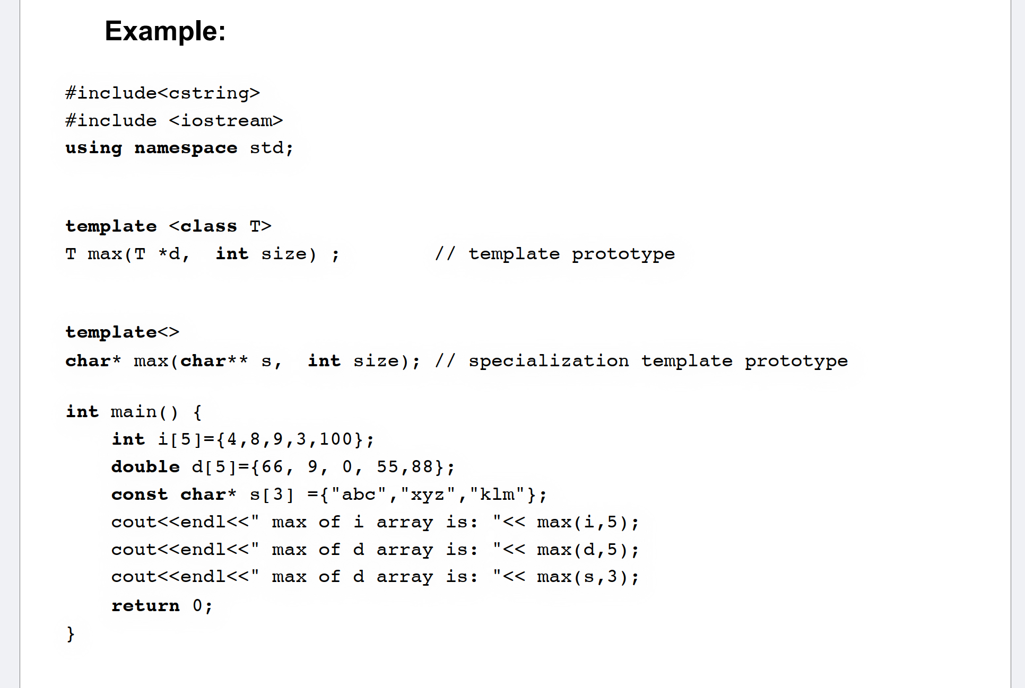

Slide 14
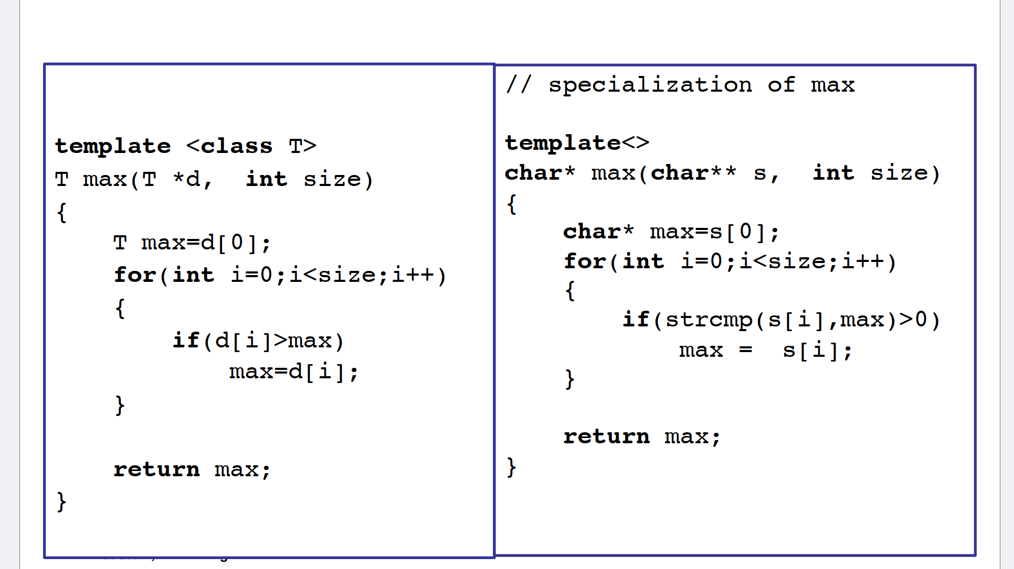

Slide 15
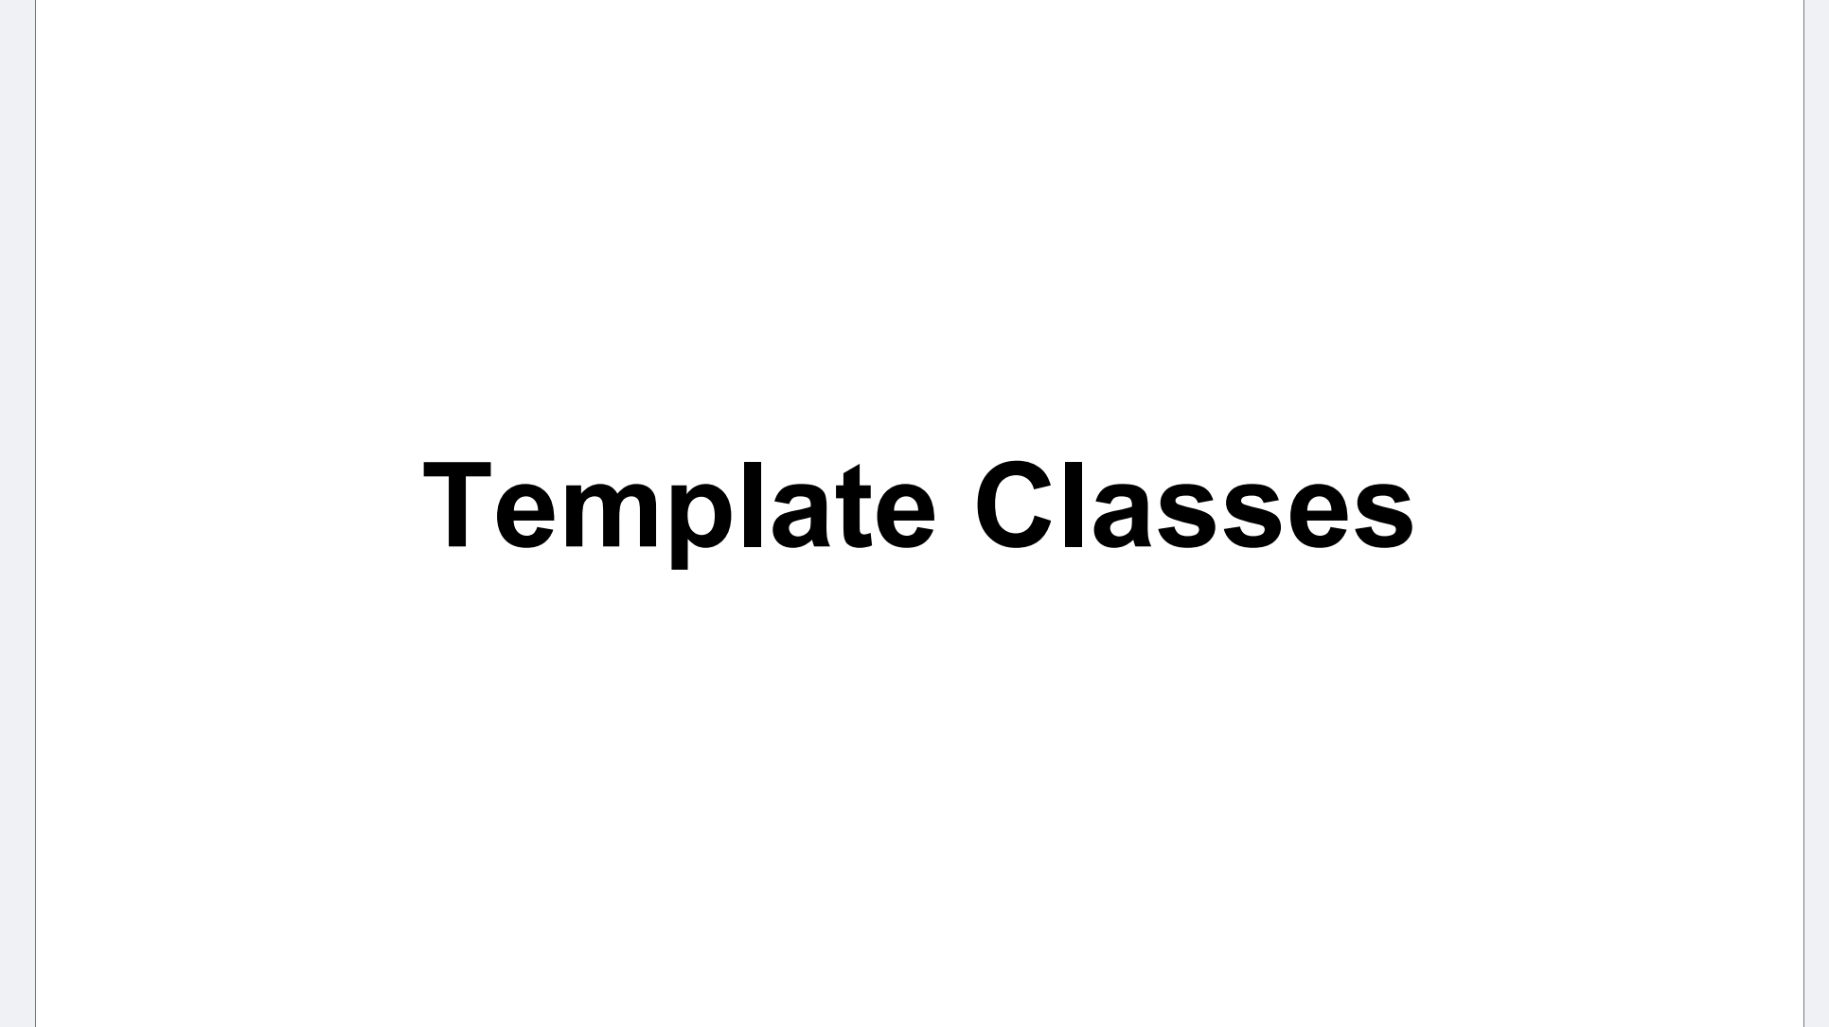

Slide 16
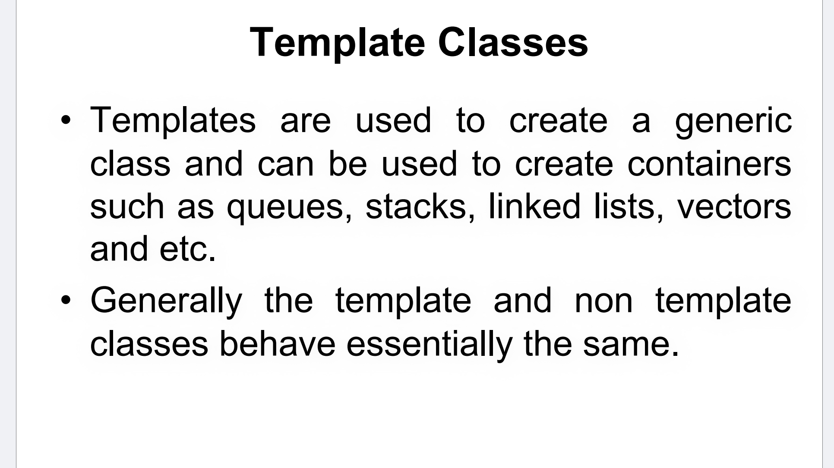

Slide 17
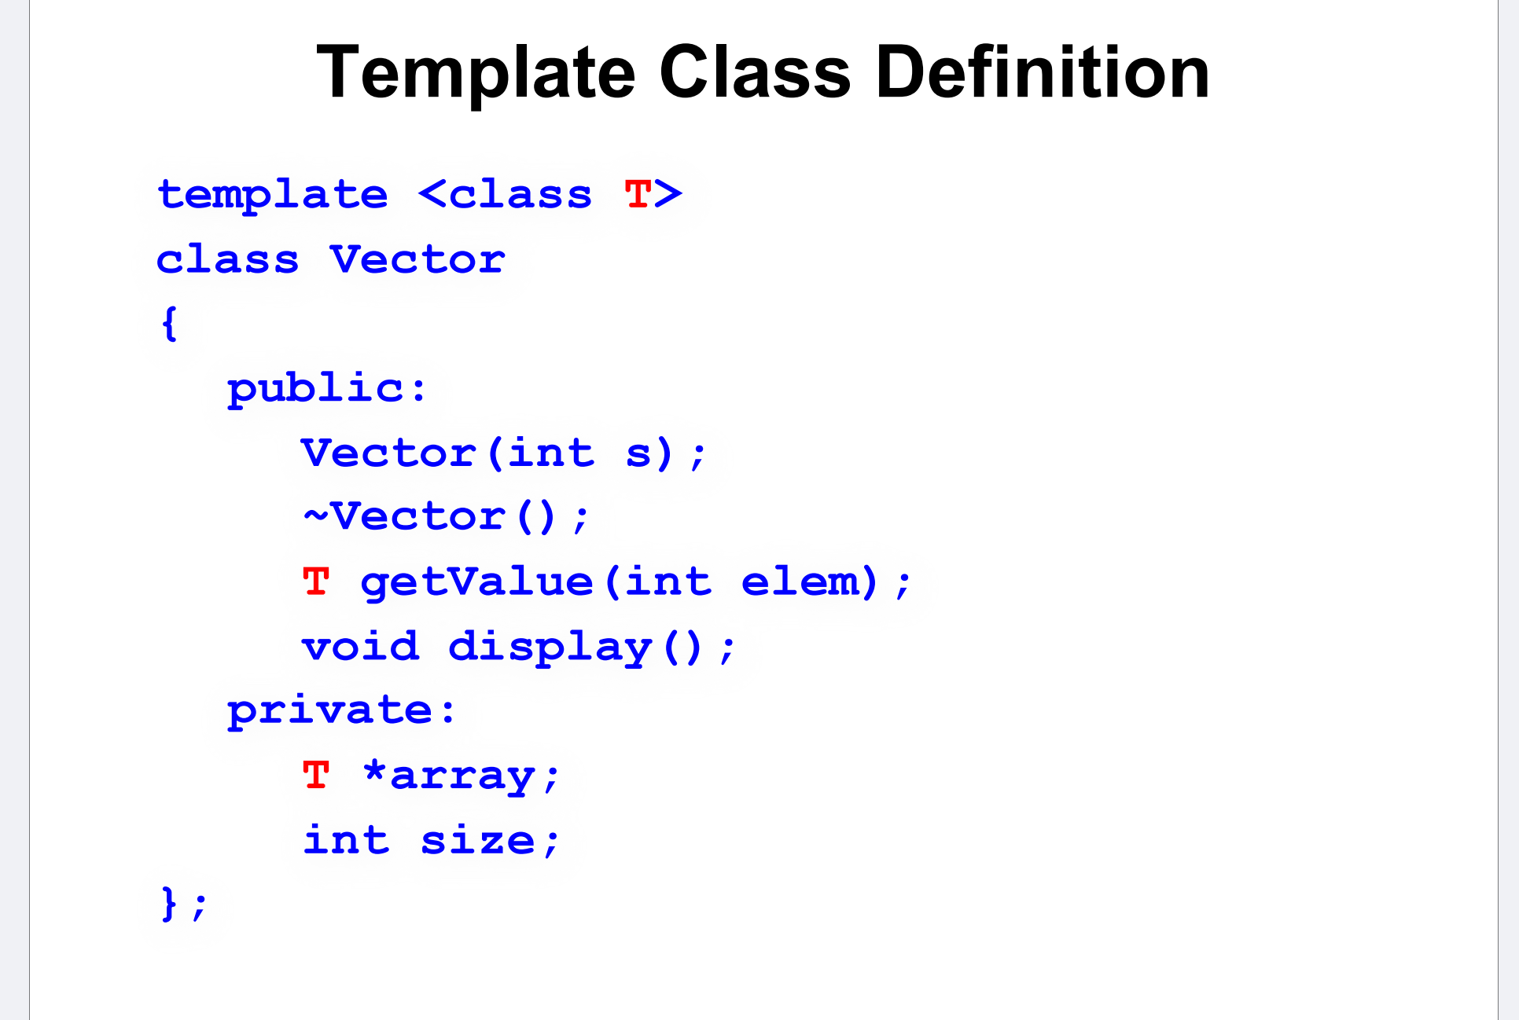

Slide 18
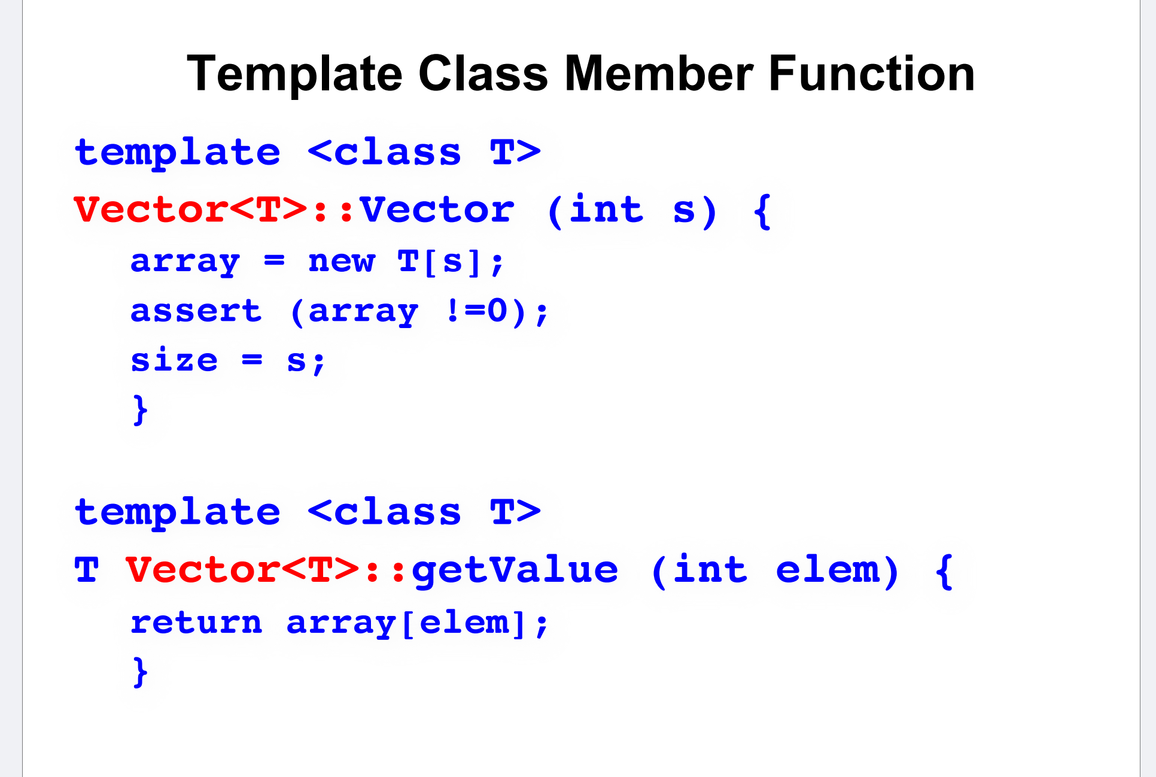

Slide 19
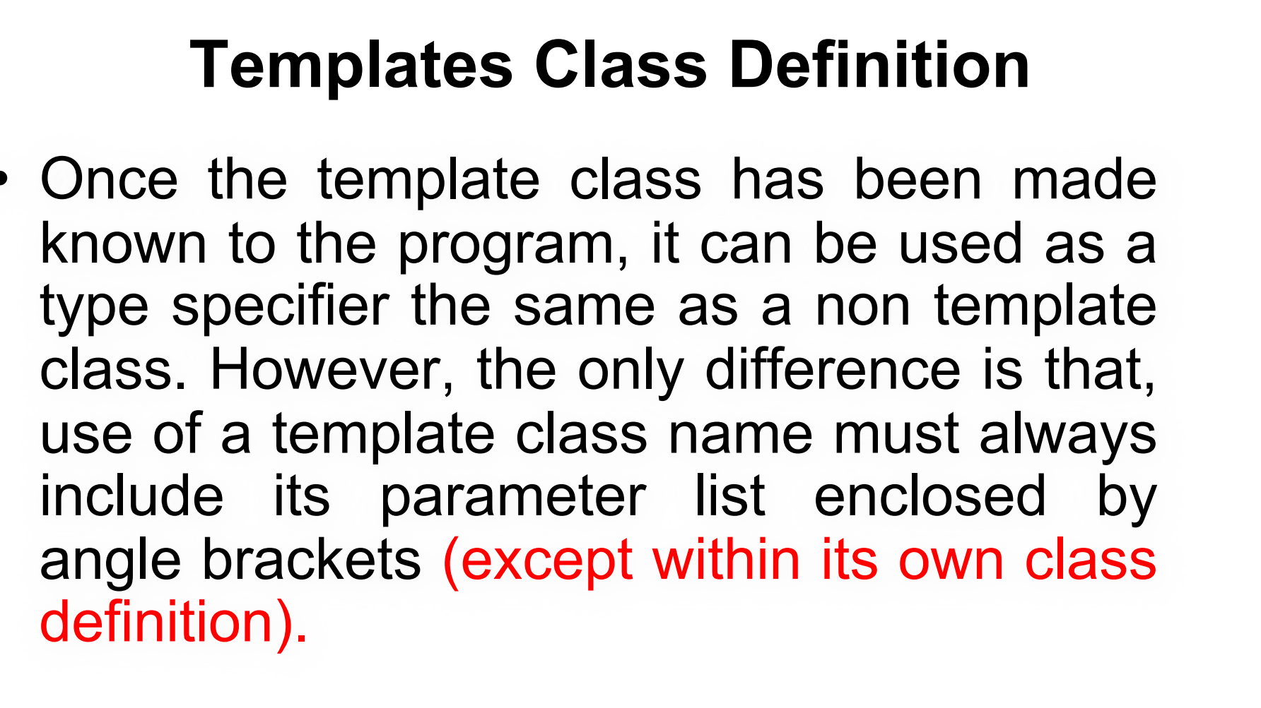
Vector<int> intVector;

Slide 20
template <class T>
class Box {
public:
Box(T value) : value(value) {}
void display() {
cout << "Value: " << value << endl;
}
// Function to get the value
T getValue() {
return value;
}
private:
T value;
};
int main() {
Box<int> intBox(10); // Template class instantiation
intBox.display(); // Outputs: Value: 10
Box<string> strBox("Hello"); // Another instantiation with a different type
strBox.display(); // Outputs: Value: Hello
return 0;
}

Slide 21
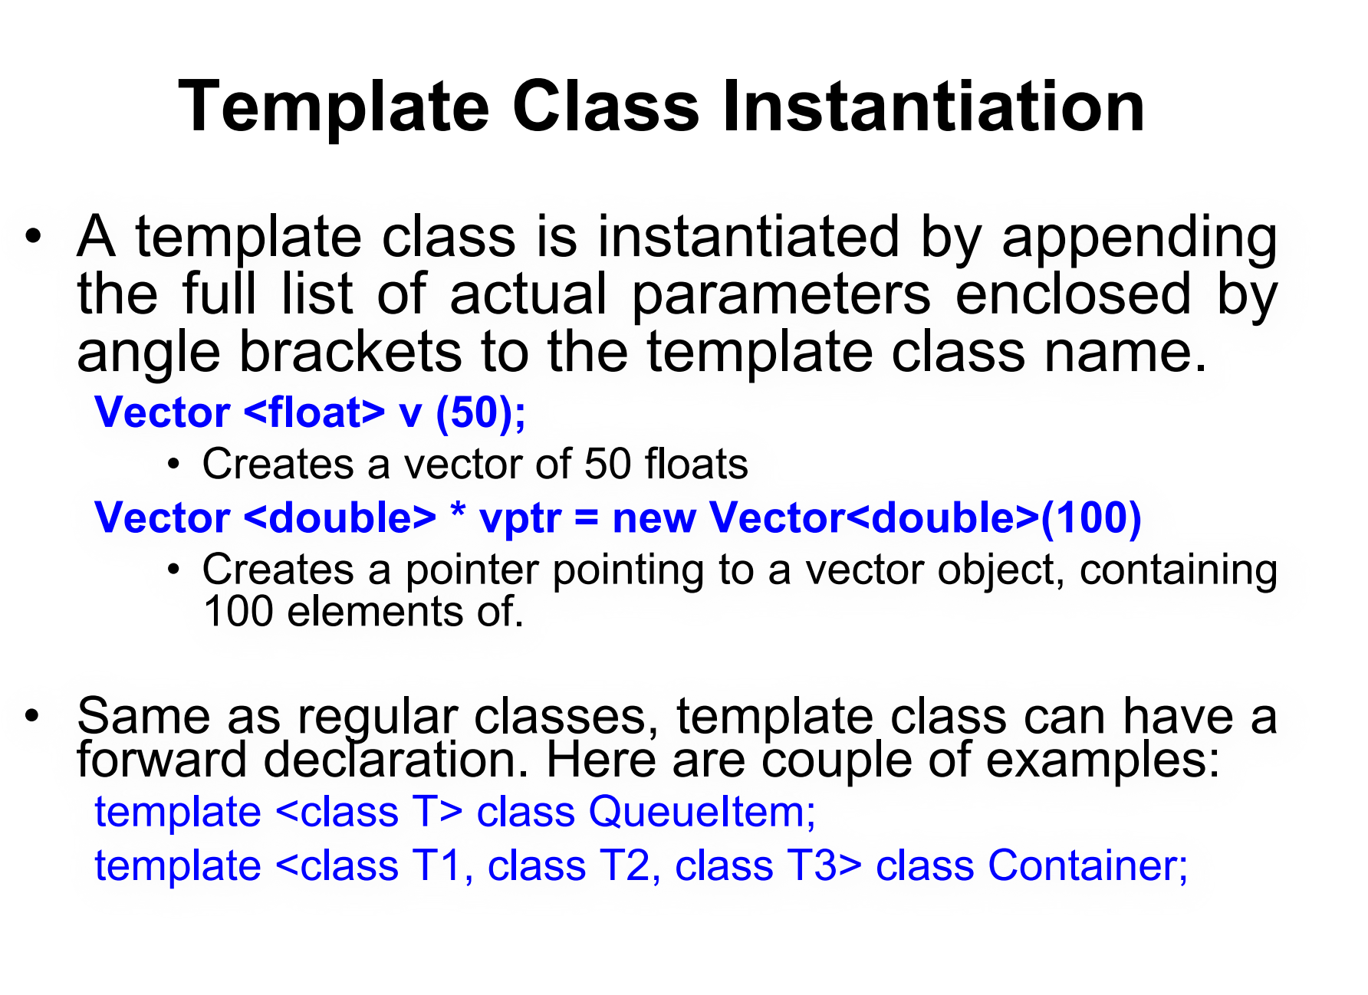

Slide 22
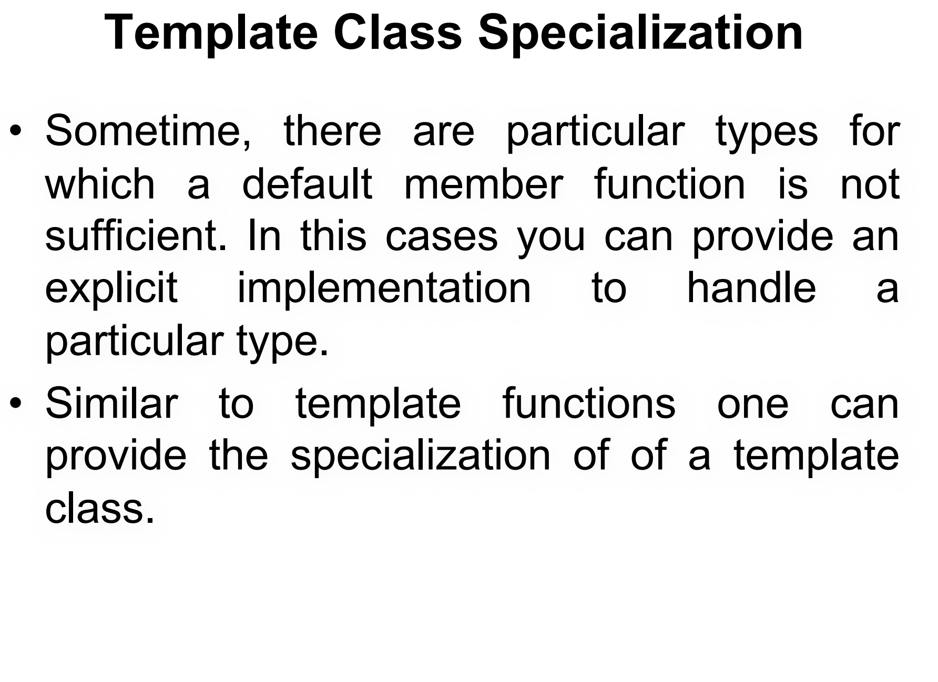

Slide 23
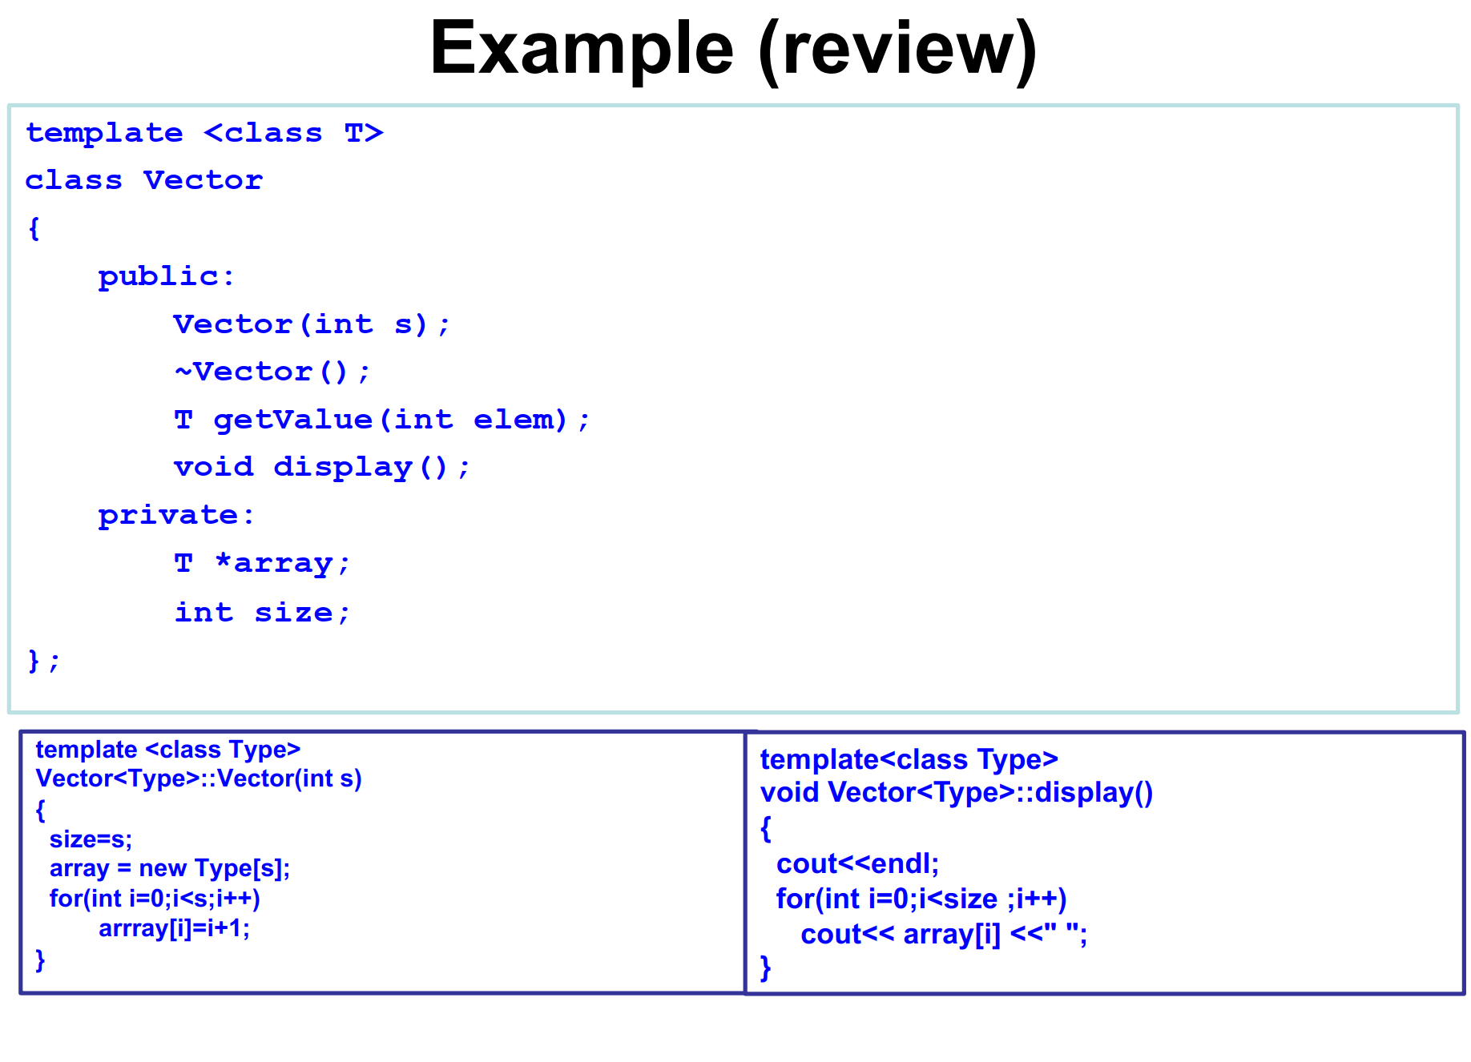

Slide 24
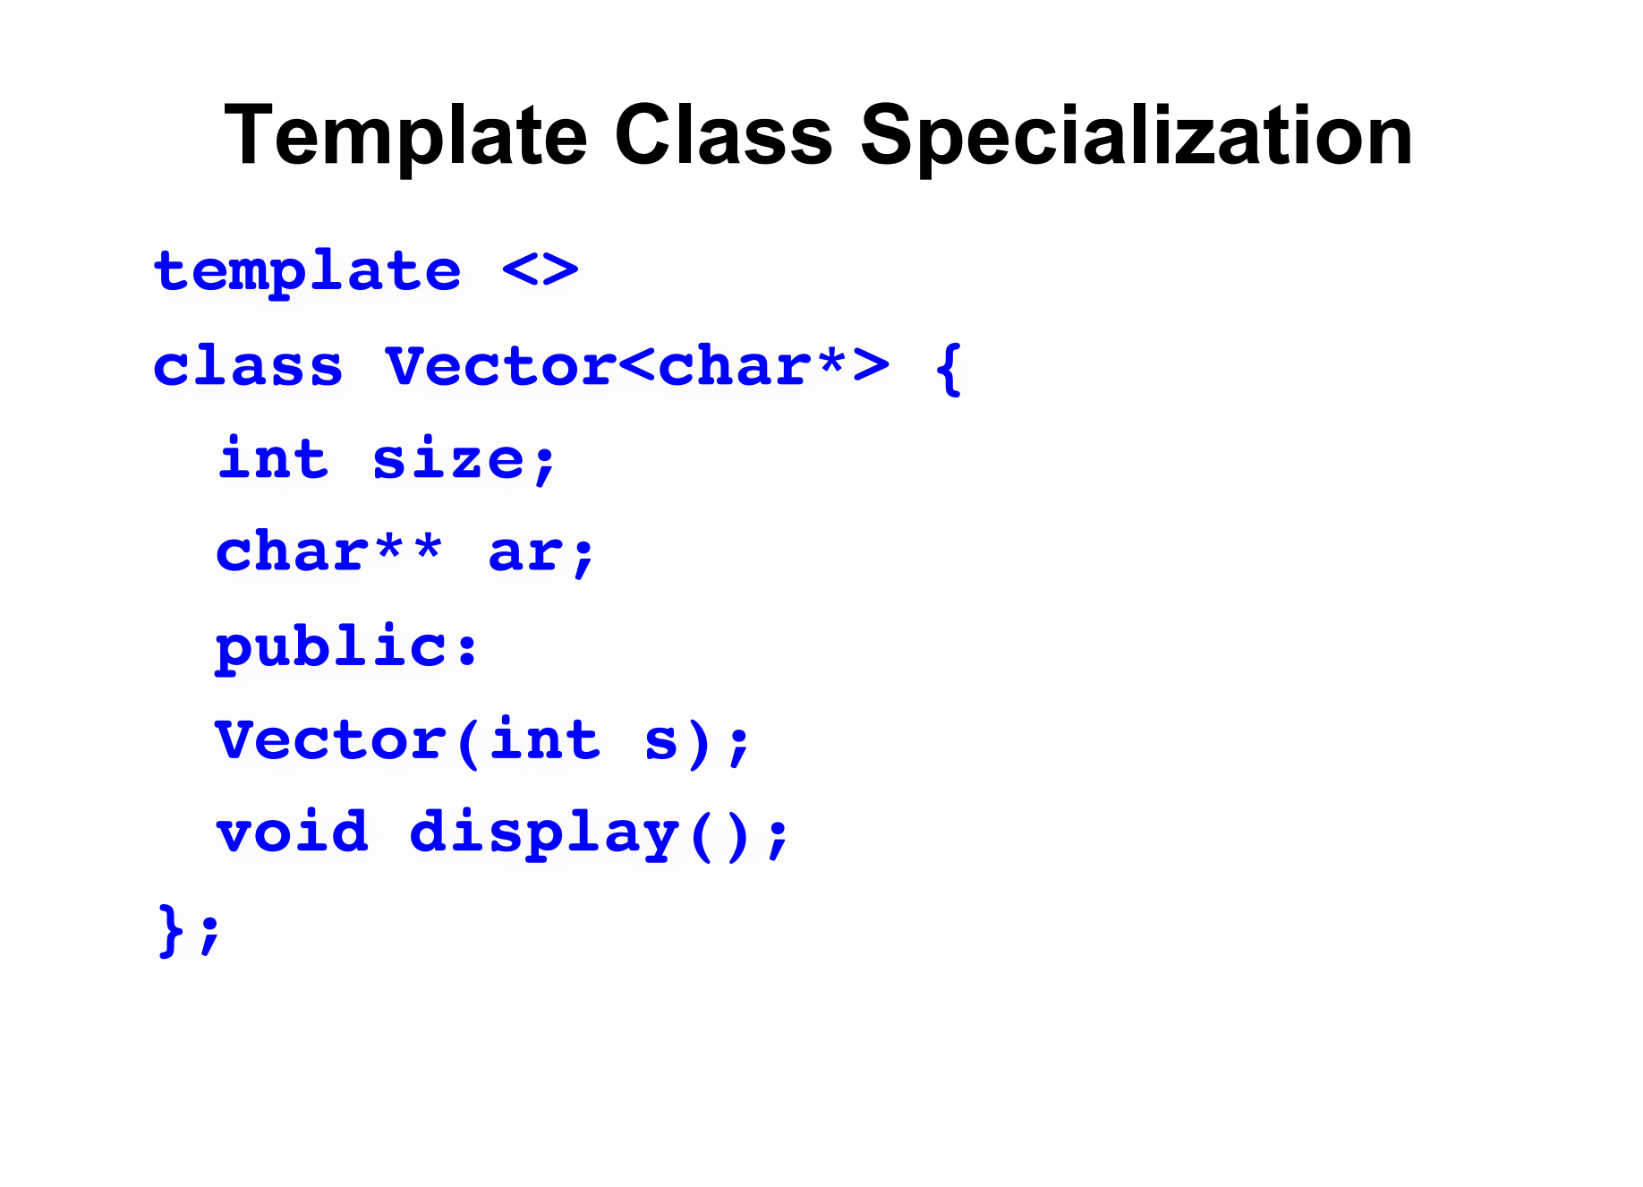

Slide 25
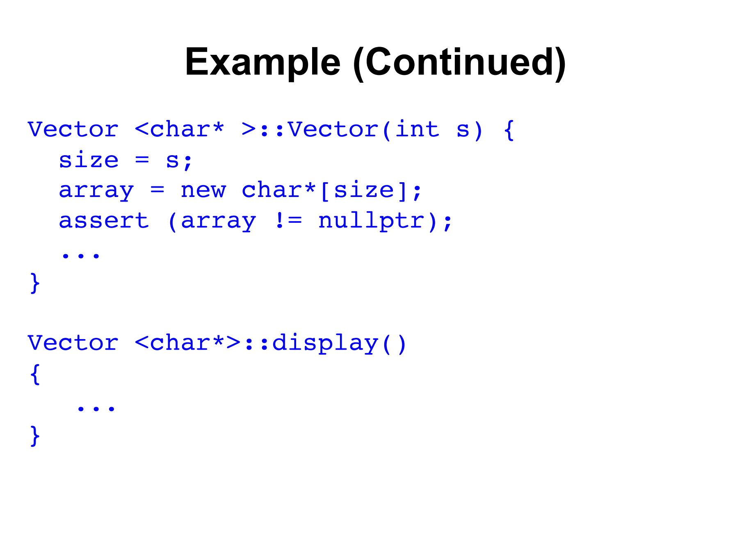

Slide 26
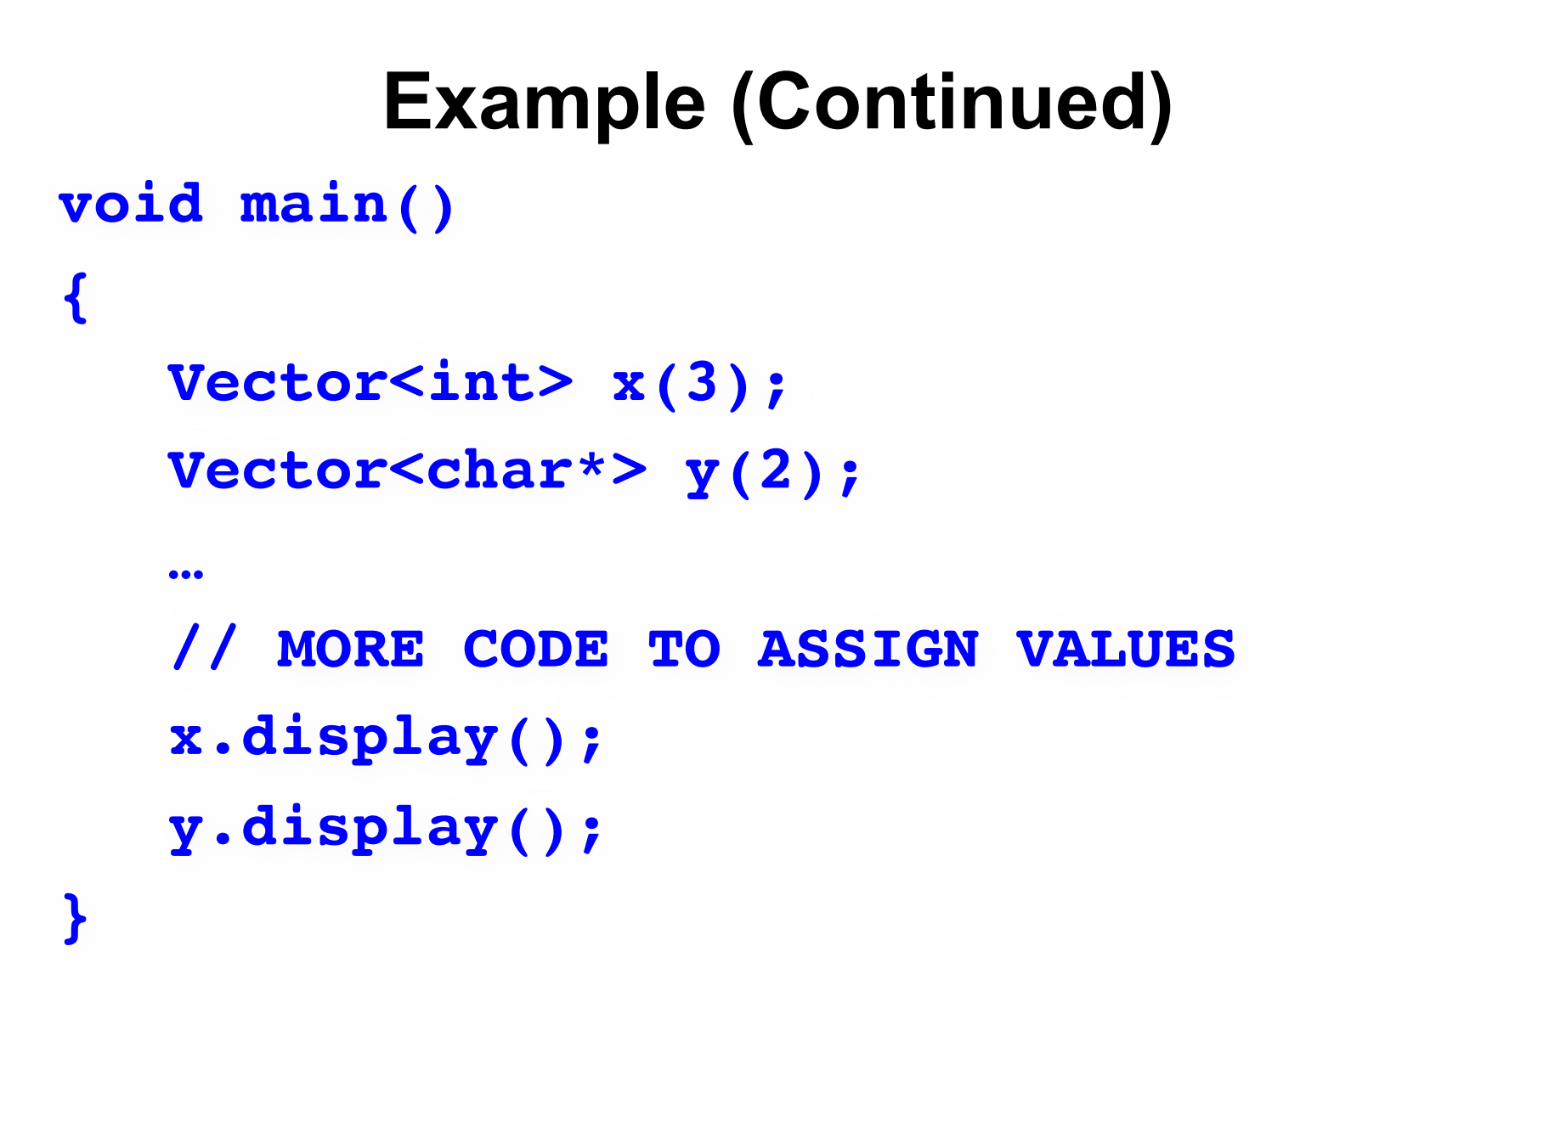

Slide 27
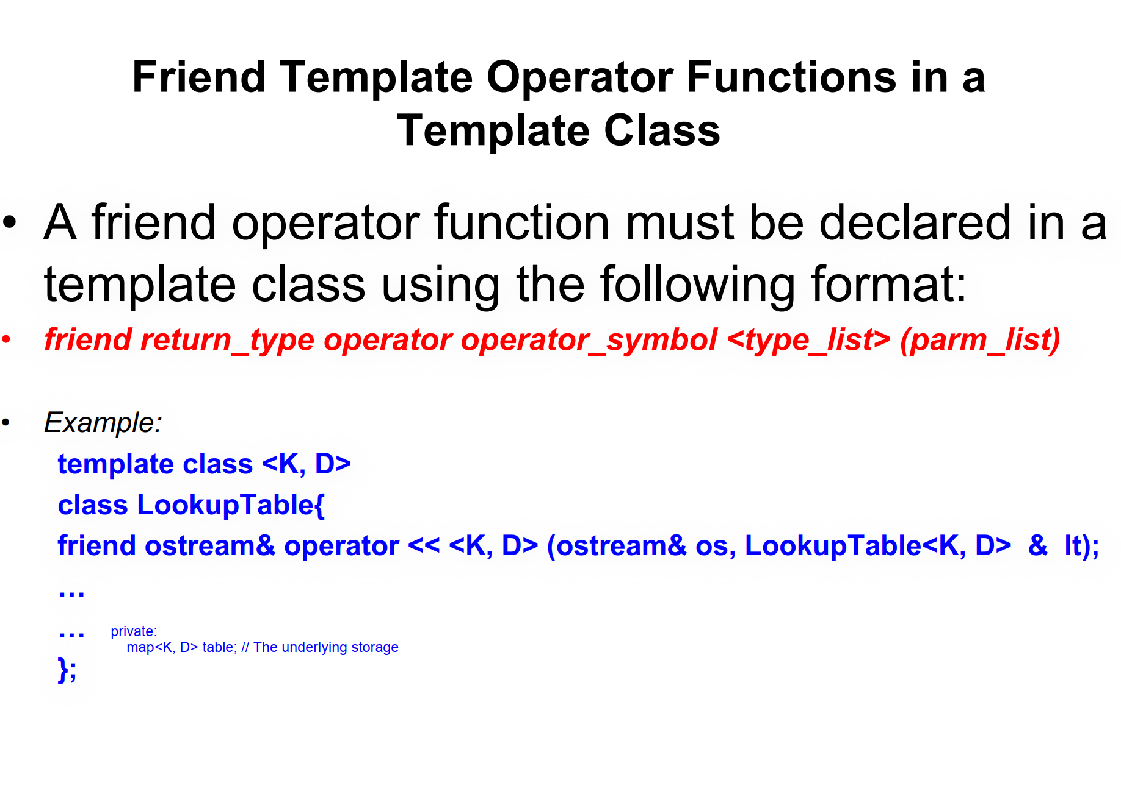

Slide 28
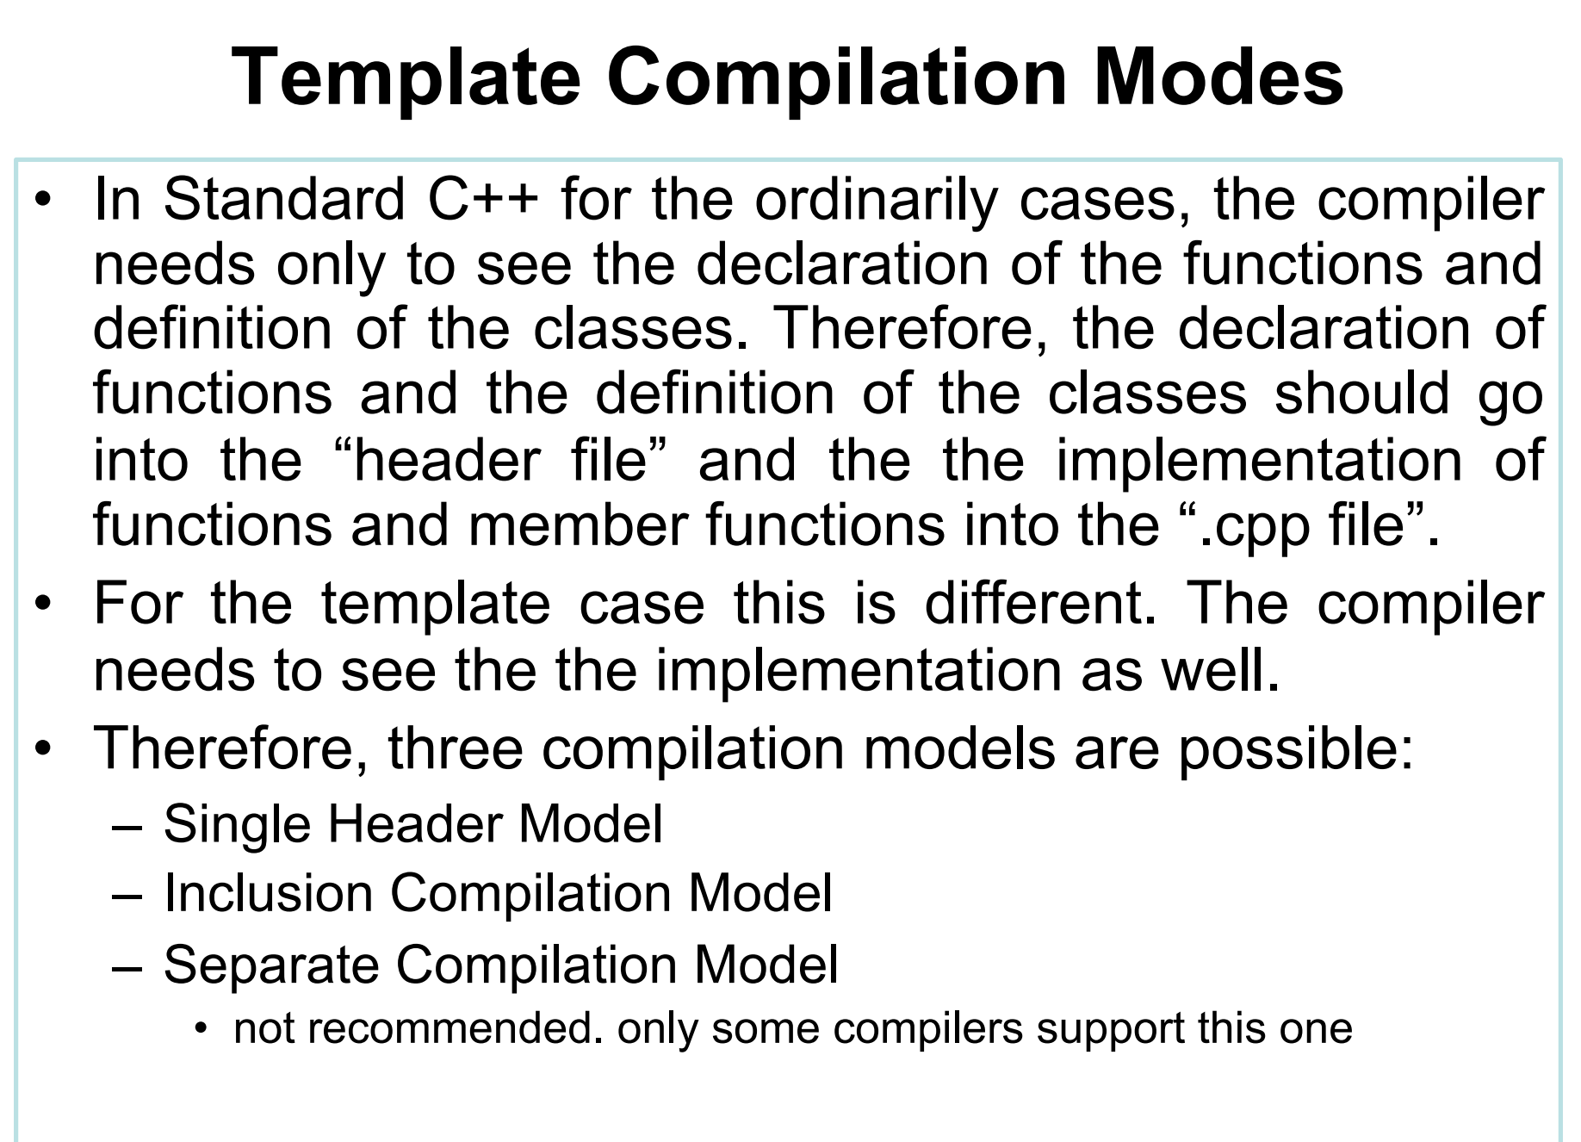

Slide 29
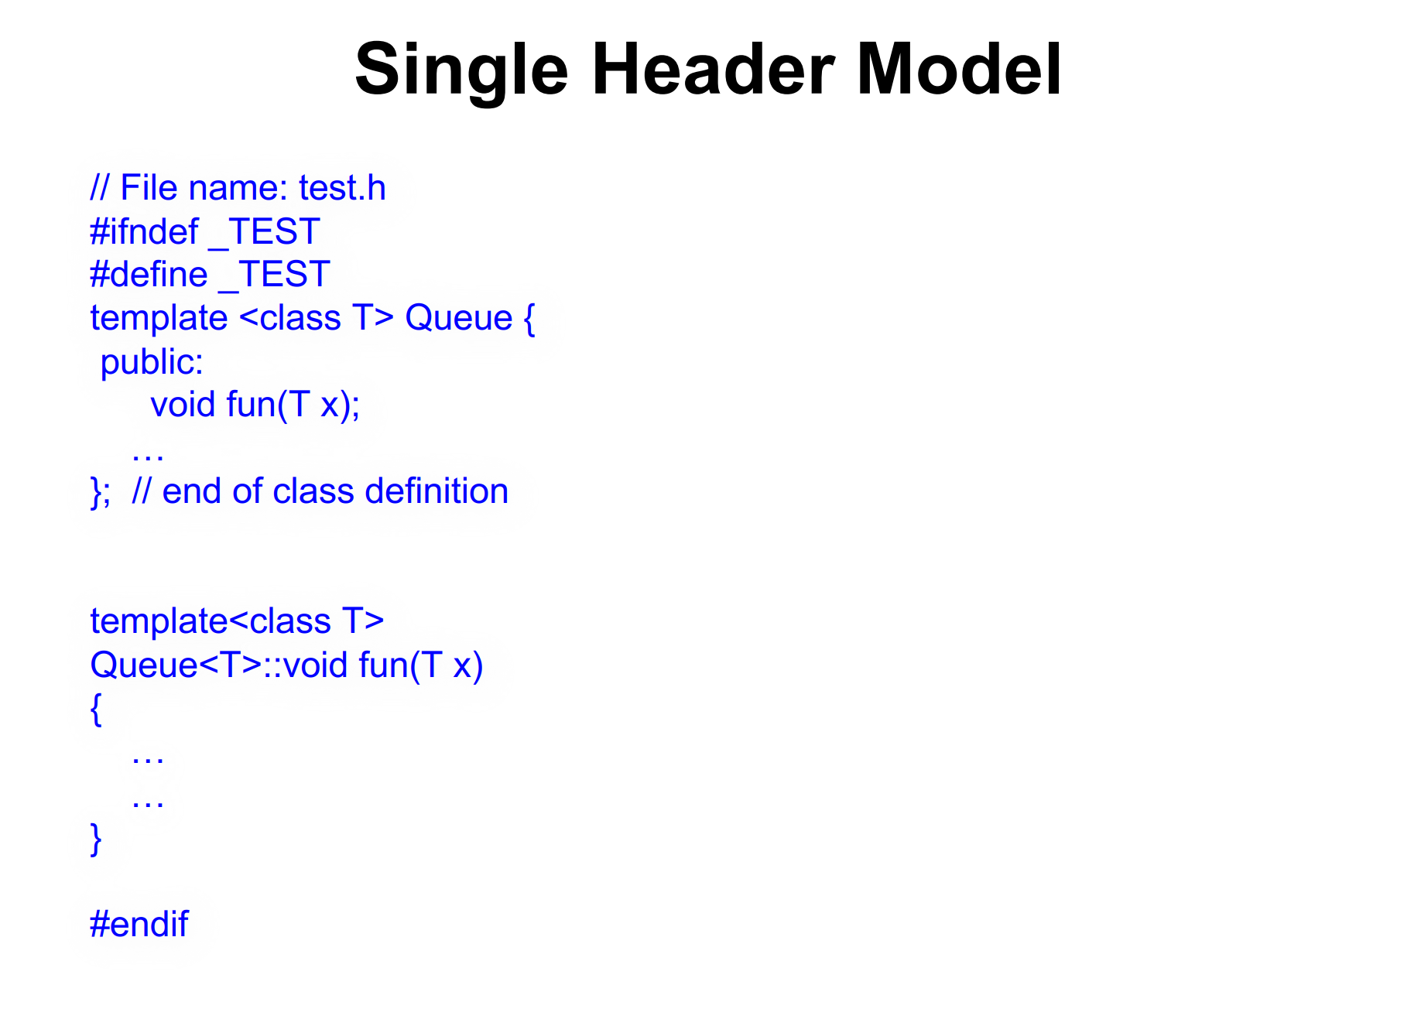

Slide 30
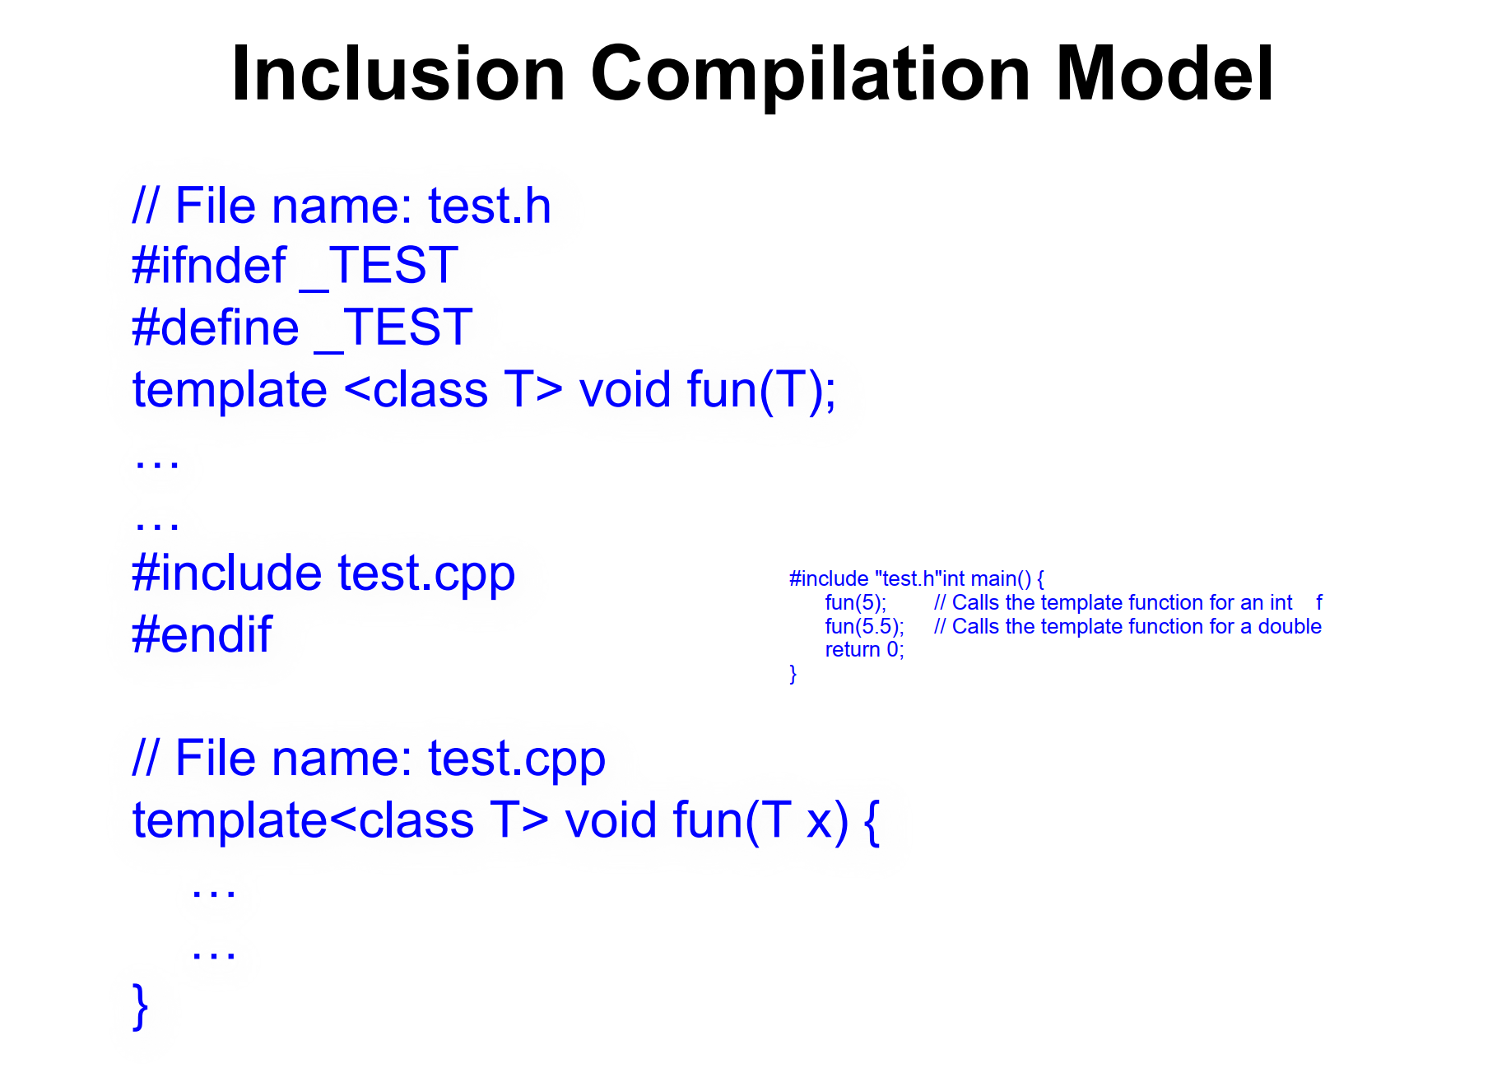

Slide 31
Separate Compilation Model
// File name: test.h
#ifndef _TEST
#define _TEST
template <class T>
void fun(T); // Declaration only
#endif
// File name: test.cpp
template <class T>
void fun(T x) {
// Implementation
}

